Slide 1

THE “JOBNET WEBSITE”PROJECT
Aryan Jain , Avi Tripati , Divyadarshan Choubisa

Slide 2
INTRODUCTION
The job industry is facing a lot of competition along with the growth of society and the need for qualified manpower. Unlike the old days, today there are many options for the same and with the advent of internet this process has become easier and user-friendly. The search for the right job sometimes makes the seekers run here & there and this is where the Placement consultants come in, by acting as a platform between them and the premier hiring companies. A Placement Consultancy or a Recruitment firm acts as a link between the companies that offer jobs in various areas and the job- seekers. They also help reduce the clutter and streamline the manpower hunting for the companies no matter how big or small. They act as a guide to the job-seeker to guide them with their career prospects. Many companies hire these recruitment firms or agencies to help them find the right qualified candidate to join their company. Job seekers in turn, contact these recruitment firms to apply for the right job.

Slide 3
Technical Specification
Specifications of the System used to develop and test the website-:
Software Requirements-
Operating Systems : Windows 10
Designing Languages : HTML, CSS, JAVASCRIPT
Toolkit : Notepad++ ,XAMP
Programming Language :PHP

Slide 4
Hardware Requirements-
● RAM required for PHP:512MB
● Processor required: Intel(R) Core(TM) i5-5287U CPU @ 2.90GHz 2.90 GHz
● Hard Disk required : 128GB

Slide 5
Requirements
Web Browsers-
Google Chrome
Mozilla Firefox 61
Microsoft Edge
Template-
Bootstrap-job consultancy site

Slide 6
Front & Back End Tools :-
S.No | Particulars | Technology
1 | Server Side language | PHP
2 | Database | My SQL
3 | Designing | CSS 3
4 | Validation Animation | JQuery
5 | Retrieve Data From the Database | AJAX
6 | Structure Designing | HTML 5
7 | Program the behaviour of web pages | Java Script
8 | Responsive | Bootstrap 4

Slide 7
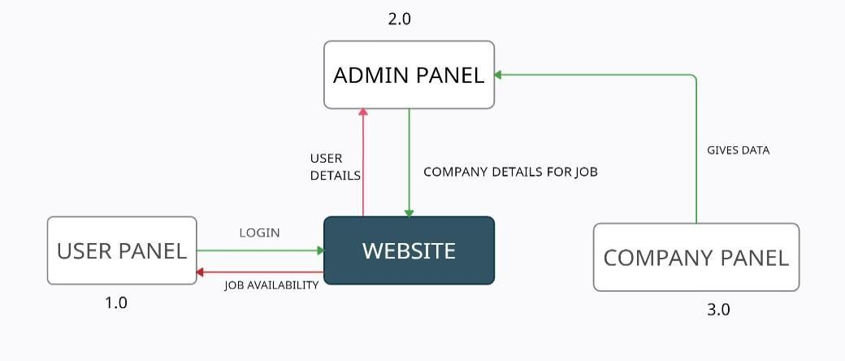
Data Flow Diagram Zero level DFD diagram:

Slide 8
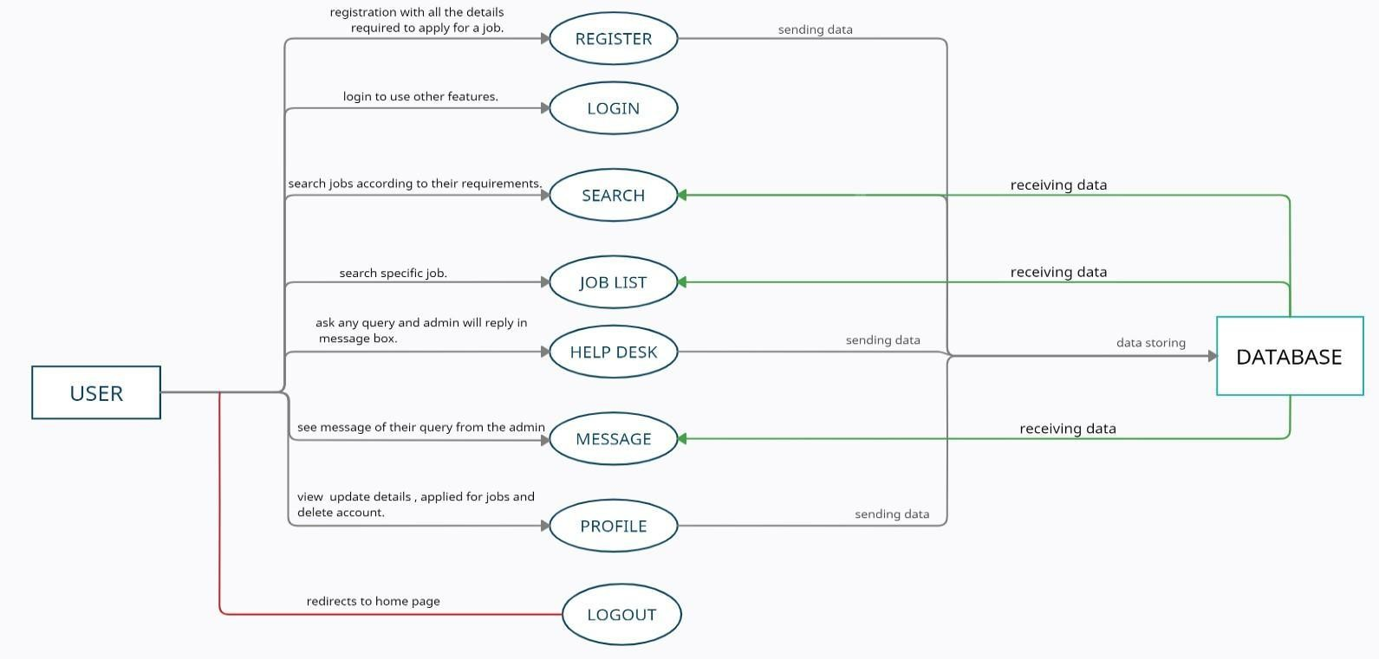
Level one DFD for 1.0:

Slide 9
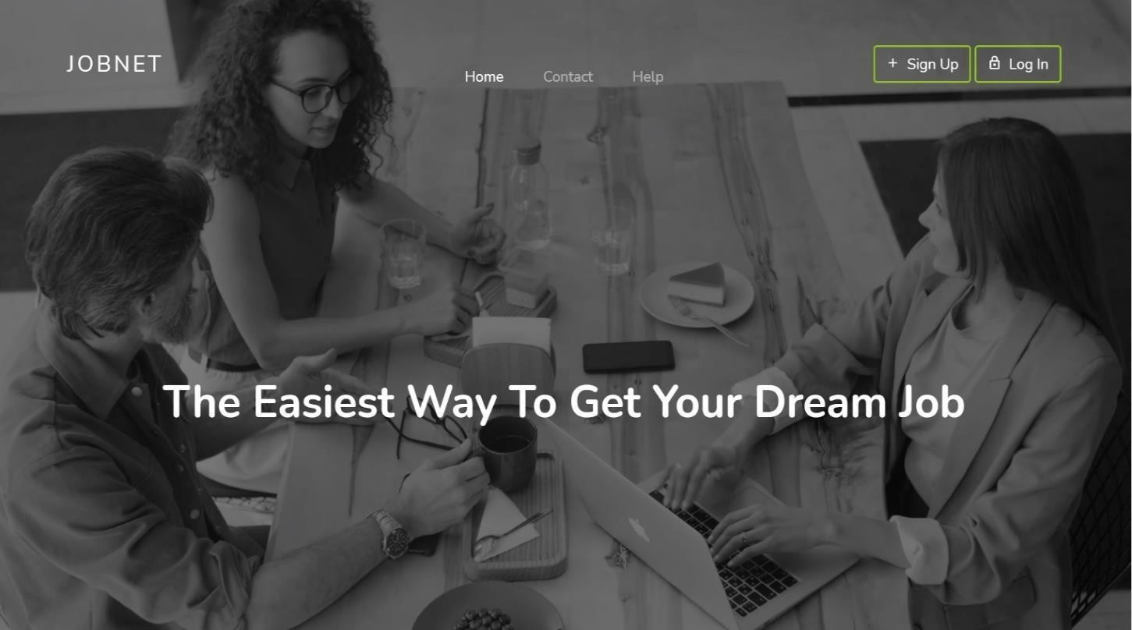
Snapshot Of Designing Phase

Slide 10
Future Scope :-
* If websites app is made for mobile then it would be easier for user to use it.
* Website should be made responsive for better use .
* Jobs for fresher and internships should also be added as a feature in this website. * Paid membership for the users.

Slide 11
Project Timeline :-
Beginning
10 dec. 2021
Under Process
Completion
May 2022

Slide 12
THANK YOU

